Slide 1
Semester .Net on the Server
Web Infrastructures
Les 7
Programming HTTP
Notes:
https://www3.ntu.edu.sg/home/ehchua/programming/webprogramming/HTTP_Basics.html
Images from:
HTTP: The definitive guide
O’Reilly Media
ISBN: 978-1-56592-509-0
http://4free-ebooks.com/ebook/http-the-definitive-guide/bifcgp6co

Slide 2
Overview
Communication protocols
HTTP basics

Slide 3
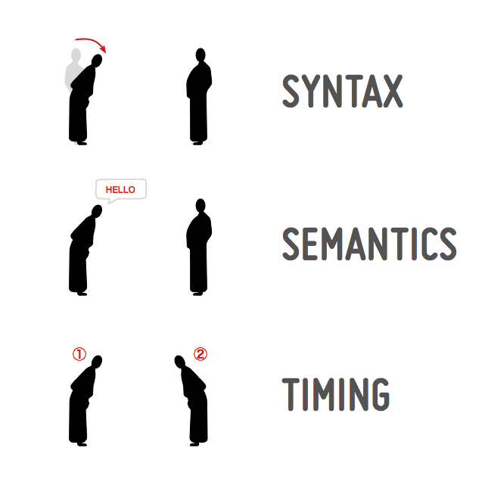
Communication
To be able to communicate, two parties need:
Syntax
(data format and coding)
Semantics
(control information and error handling)
Timing
(speed matching and sequencing)
Notes:
https://dev.opera.com/articles/http-basic-introduction/

Slide 4
Communication Protocol
An online communication protocol contains the same elements:
The syntax will be the sequence of characters such as keywords we use for writing the protocols.
The semantics is the meaning associated with each of these keywords
The timing is the order in which two or more parties exchange these keywords

Slide 5

HTTP
In this course, the HTTP protocol will be the main subject.
The Hypertext Transfer Protocol (HTTP) is an application-level protocol with the lightness and speed necessary for distributed, collaborative, hypermedia information systems. It is a generic, stateless, protocol which can be used for many tasks.

Slide 6
HTTP History
1991 HTTP/0.9
Tim Berners-Lee
HTML, URI
1996 HTTP/1.0
RFC 1945 https://tools.ietf.org/html/rfc1945
1997 HTTP/1.1 draft
RFC 2068 https://tools.ietf.org/html/rfc2068
1999 HTTP/1.1 final
RFC 2616 https://tools.ietf.org/html/rfc2616
Notes:
http://internethalloffame.org/official-biography-tim-berners-lee

Slide 7
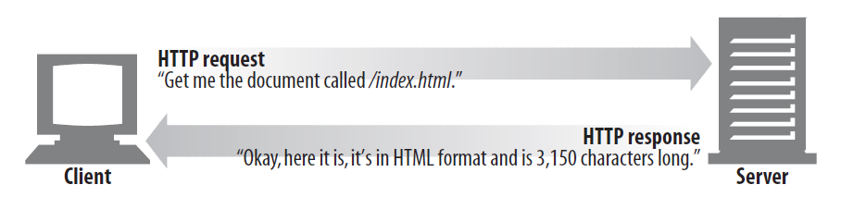
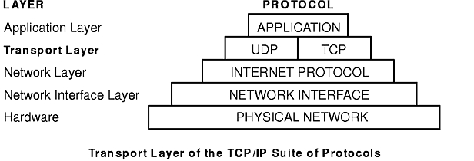
HTTP: Application Level Protocol
HTTP uses request-response messaging pattern
in a client-server model.
Sits “on top” of a reliable Transport Protocol, where TCP is most commonly used
Notes:
https://en.wikipedia.org/wiki/Request%E2%80%93response
https://en.wikipedia.org/wiki/Client%E2%80%93server_model
http://ps-2.kev009.com/wisclibrary/aix51/usr/share/man/info/en_US/a_doc_lib/aixbman/commadmn/tcp_protocols.htm
https://en.wikipedia.org/wiki/Internet_protocol_suite

Slide 8
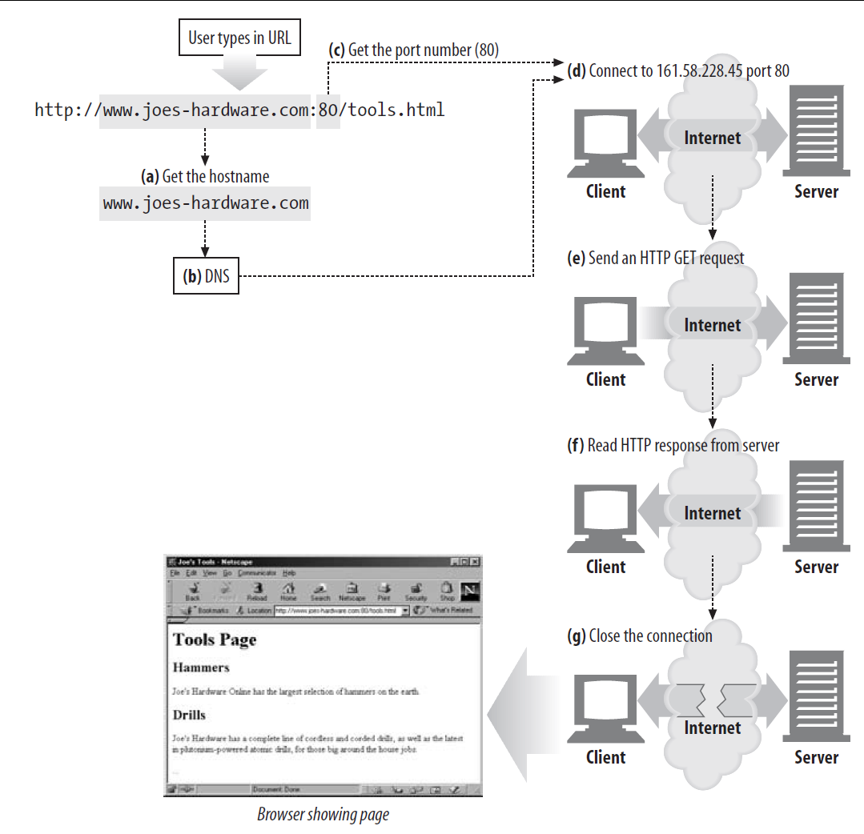

HTTP Transaction Process
Notes:
Note: HTTP is a connection-less protocol: Connection is broken when transaction is complete.
The combination of stateless and connectionless make multi-threaded handling viable (because requests are independent)

Slide 9
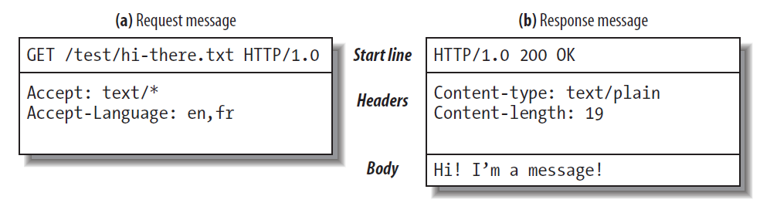
Anatomy of a HTTP Message
HTTP Messages are simple, line-oriented sequences of characters
Generic format for request and response
RFC 822
Human readable & writable
Easy to debug
But: hard for developer to parse and process
Notes:
HTTP uses generic format RFC 822

Slide 10
Anatomy of a HTTP Message Request line
Start line = Request-line | Status-line
Request-line: tells a server what to do with a particular resource (HTTP Method) and which HTTP version is used in the communication
Common HTTP Methods ^{*See W3 for full list}
GET Send resource from server to client
POST Send data to server resource
HEAD Send just the HTTP headers from resource on server
DELETE Remove resource from server
PUT Replace resource on server with data from client
GET /hello.htm HTTP/1.1

Slide 11
Anatomy of a HTTP Message Status line
Status-line: tells client the HTTP version and statuscode of the request
Common statuscodes:
200 OK, document is returned
302 Redirect: document can be found elsewhere
404 Not found. Document is not on the server
HTTP/1.1 200 OK

Slide 12
Anatomy of a HTTP Message Header fields
Header fields:
Zero or more header fields follow the start line. Each header field consists of a name and a value, separated by a colon (:) for easy parsing.
The headers end with a blank line*: CRLF**
*Can in some cases be used as the TCP message-marker
**CRLF: Carriage Return (ASCII 13), Line Feed (ASCII 10)
Headers are used for specifying the capabilities of client/server, preferences of the user, cookies etc

Slide 13
Anatomy of a HTTP Message Message body
Body
After the blank line is an optional message body containing any kind of data.
Request bodies carry data to the web server; response bodies carry data back to the client.
Unlike the start lines and headers, which are textual and structured, the body can contain arbitrary binary data (e.g., images, videos e.a).
Of course, the body can also contain text.

Slide 14
Anatomy of a HTTP Message Message body
Information about the message body can be obtained from the headers, e.g.:
Content-Type: text/html
Content-Length: 16034
* Can be used as TCP message-marker

Slide 15
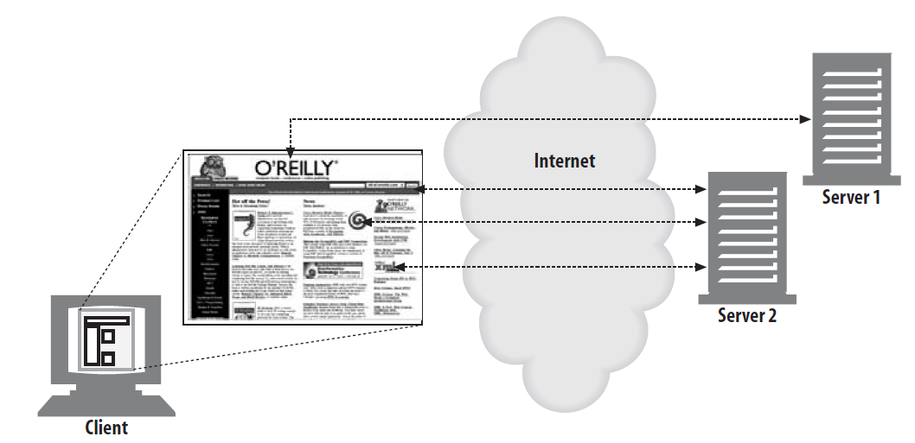
HTTP Transactions
The browser performs one transaction to fetch the HTML “skeleton” that describes the page layout
Then issues additional HTTP transactions for each embedded image, graphics pane, Java applet, etc. These embedded resources can reside on different servers

Slide 16
HTTP Programming with TCP sockets
HTTP connections are essentially TCP-connections with certain rules when to close them.
Connection Management -particularly knowing when and how to close connections- is one of the practical black arts of HTTP!
Notes:
https://developers.google.com/web/fundamentals/performance/optimizing-content-efficiency/http-caching?hl=nl

Slide 17
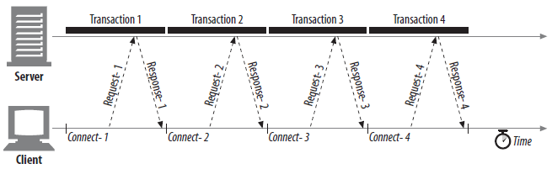
HTTP Connections
HTTP/1.0: closed after end of message
Client is responsible for opening connection
Server is (in principle) responsible for closing connection
Disconnection “at will”
All http clients, servers, proxies can close a TCP transport connection at any time
(in case of error or other reasons)
“idle” connections can be timed-out
(but how to know for sure it is really idle??)
Notes:
HTTP/1.1 has options for persistent and pipelined connections;

Slide 18
HTTP Connections
Content-Length header should always be correct, but
Header may not be omitted
Rely on server connection close
Header may be inaccurate
When connection is closed and nr bytes received does not match length: question the data received!
The proxy should forward the questionable message intact, without attempting to “correct” the Content-Length, to maintain semantic transparency.

Slide 19
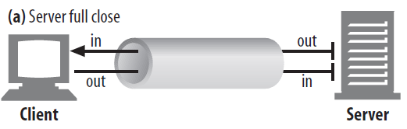
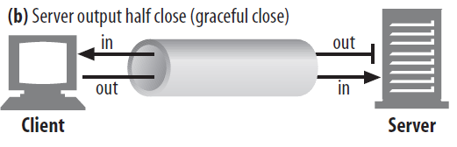
Graceful connection close
Calling .close() method of a socket is a full-close of the connection
Using the shutdown() method allows to close a input or output channel individually
Better for letting the other end know what to expect: less unexpected write errors!

Slide 20
Graceful connection close
Closing the output channel of your connection is always safe.
The peer on the other side of the connection will be notified that you closed the connection by getting an end-of-stream notification once all the data has been read from its buffer.
Closing input is riskier
If other side sends data to closed input, OS will give a serious TCP “Connection reset by peer” error.
All buffered data will be erased, even though probably much of it will be ok

Slide 21
Graceful close: How?
Close output channel
Wait for other side to close its output channel
Then fully close connection
There is no way to know if client supports graceful close:
Periodically check status if input channels
When certain timeout nothing is received, force connection close

Slide 22
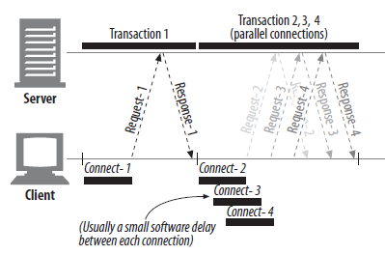
Parallel Connections
HTTP allows clients to open multiple connections in parallel
1. Completely request HTML
2. Request resources in parallel
CSS, JS, images etc
Pages “feel” loading faster
Actually slower over low bandwidth
Parallel connections consume lots of resources on server, high-load proxies
100 users with 100 parallel connections = 10.000 connections to manage
Therefore, browsers limit parallel connections to 4-6 per domain
Notes:
Parallel connection limit for browsers: http://www.browserscope.org/?category=network&v=top

